Slide 1
DSI 8 – Project 1
EDA and Data Wrangling for
SAT and ACT scores, 2017 - 2018
By Group 3:
Justin Tee, Chang Chu Hua, Alfred Tang
DSI 8, General Assembly
23 May 2019

Slide 2
Introduction
SAT format changed in 2016
Now there are 2 years of data to compare, post-change
Task: Analyse data and present findings to College Board staff

Slide 3
Problem Statement
In which states are participation rates increasing after re-design of SAT?
Are more students achieving the benchmark scores after the re-design?

Slide 4
DATA Cleaning (2017)
Issues:
Row counts not matching
ACT 2017 National Composite
Typos
SAT 2017 Maryland Math Score → 52 instead of 524

Slide 5
DATA Cleaning (2017)
Issues (Cont’d):
Data Entry
ACT 2017 Wyoming Composite → 20.2x
ACT 2017 Maryland Science → 2.3 → 23.2
Data Types
Participation entered as strings
Replaced % with blank; converted to float

Slide 6
DATA Gathering (2018)
Issues:
Source Data not complete
Composite column was the only usable column
Separately gathered score data
Data not matching
SAT scores did not match Totals
+1/-1 differences ignored.
Difference is due to rounding
Officially stated by College Board.

Slide 7
DATA Cleaning (2018)
Issues:
Row counts not matching
2018 National averages
Data Types
Participation again entered as strings

Slide 8
EDA: Summary Statistics
 | count | mean | std | min | 25% | 50% | 75% | max
sat_2017_participation | 51.0 | 0.398039 | 0.352766 | 0.02 | 0.040 | 0.38 | 0.660 | 1.0
sat_2017_erw | 51.0 | 569.117647 | 45.666901 | 482.00 | 533.500 | 559.00 | 613.000 | 644.0
sat_2017_math | 51.0 | 556.882353 | 47.121395 | 468.00 | 523.500 | 548.00 | 599.000 | 651.0
sat_2017_total | 51.0 | 1126.098039 | 92.494812 | 950.00 | 1055.500 | 1107.00 | 1212.000 | 1295.0
act_2017_participation | 51.0 | 0.652549 | 0.321408 | 0.08 | 0.310 | 0.69 | 1.000 | 1.0
act_2017_english | 51.0 | 20.931373 | 2.353677 | 16.30 | 19.000 | 20.70 | 23.300 | 25.5
act_2017_math | 51.0 | 21.182353 | 1.981989 | 18.00 | 19.400 | 20.90 | 23.100 | 25.3
act_2017_reading | 51.0 | 22.013725 | 2.067271 | 18.10 | 20.450 | 21.80 | 24.150 | 26.0
act_2017_science | 51.0 | 21.450980 | 1.739353 | 18.20 | 19.950 | 21.30 | 23.200 | 24.9
act_2017_composite | 51.0 | 21.519608 | 2.020695 | 17.80 | 19.800 | 21.40 | 23.600 | 25.5
sat_2018_participation | 51.0 | 0.466275 | 0.380142 | 0.02 | 0.045 | 0.52 | 0.795 | 1.0
sat_2018_erw | 51.0 | 567.294118 | 45.317676 | 497.00 | 535.000 | 552.00 | 616.500 | 643.0
sat_2018_math | 51.0 | 557.254902 | 48.887562 | 480.00 | 521.500 | 547.00 | 600.500 | 655.0
sat_2018_total | 51.0 | 1124.666667 | 93.867069 | 977.00 | 1062.500 | 1099.00 | 1220.000 | 1298.0
act_2018_participation | 51.0 | 0.616471 | 0.340810 | 0.07 | 0.285 | 0.66 | 1.000 | 1.0
act_2018_english | 51.0 | 20.988235 | 2.446356 | 16.60 | 19.100 | 20.20 | 23.700 | 26.0
act_2018_math | 51.0 | 21.125490 | 2.035765 | 17.80 | 19.400 | 20.70 | 23.150 | 25.2
act_2018_reading | 51.0 | 22.015686 | 2.167245 | 18.00 | 20.450 | 21.60 | 24.100 | 26.1
act_2018_science | 51.0 | 21.345098 | 1.870114 | 17.90 | 19.850 | 21.10 | 23.050 | 24.9
act_2018_composite | 51.0 | 21.486275 | 2.106278 | 17.70 | 19.950 | 21.30 | 23.550 | 25.6

Slide 9
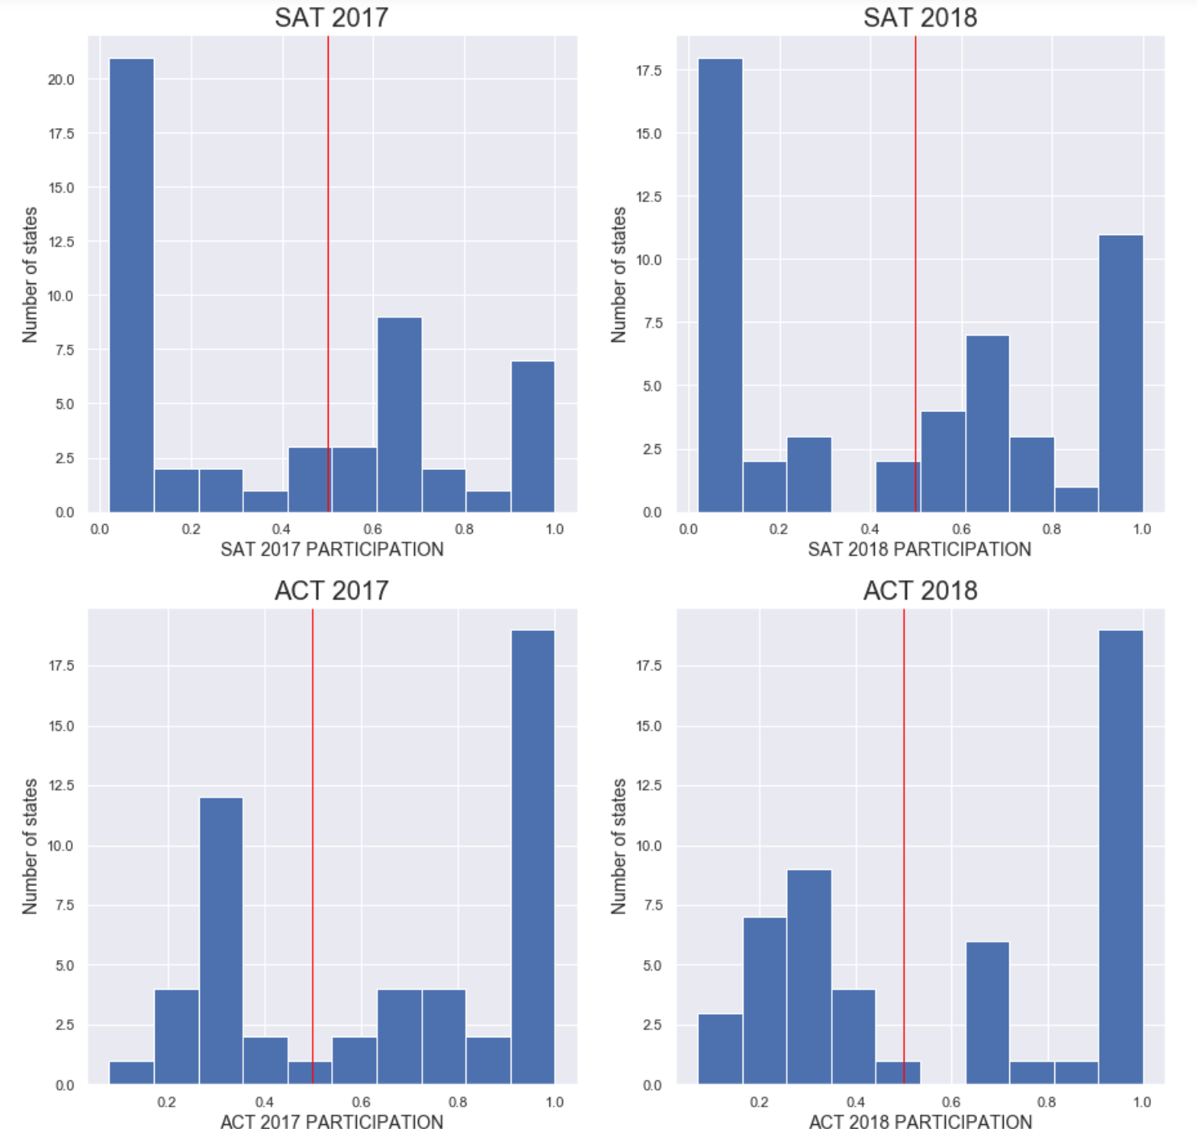
Participation

Slide 10
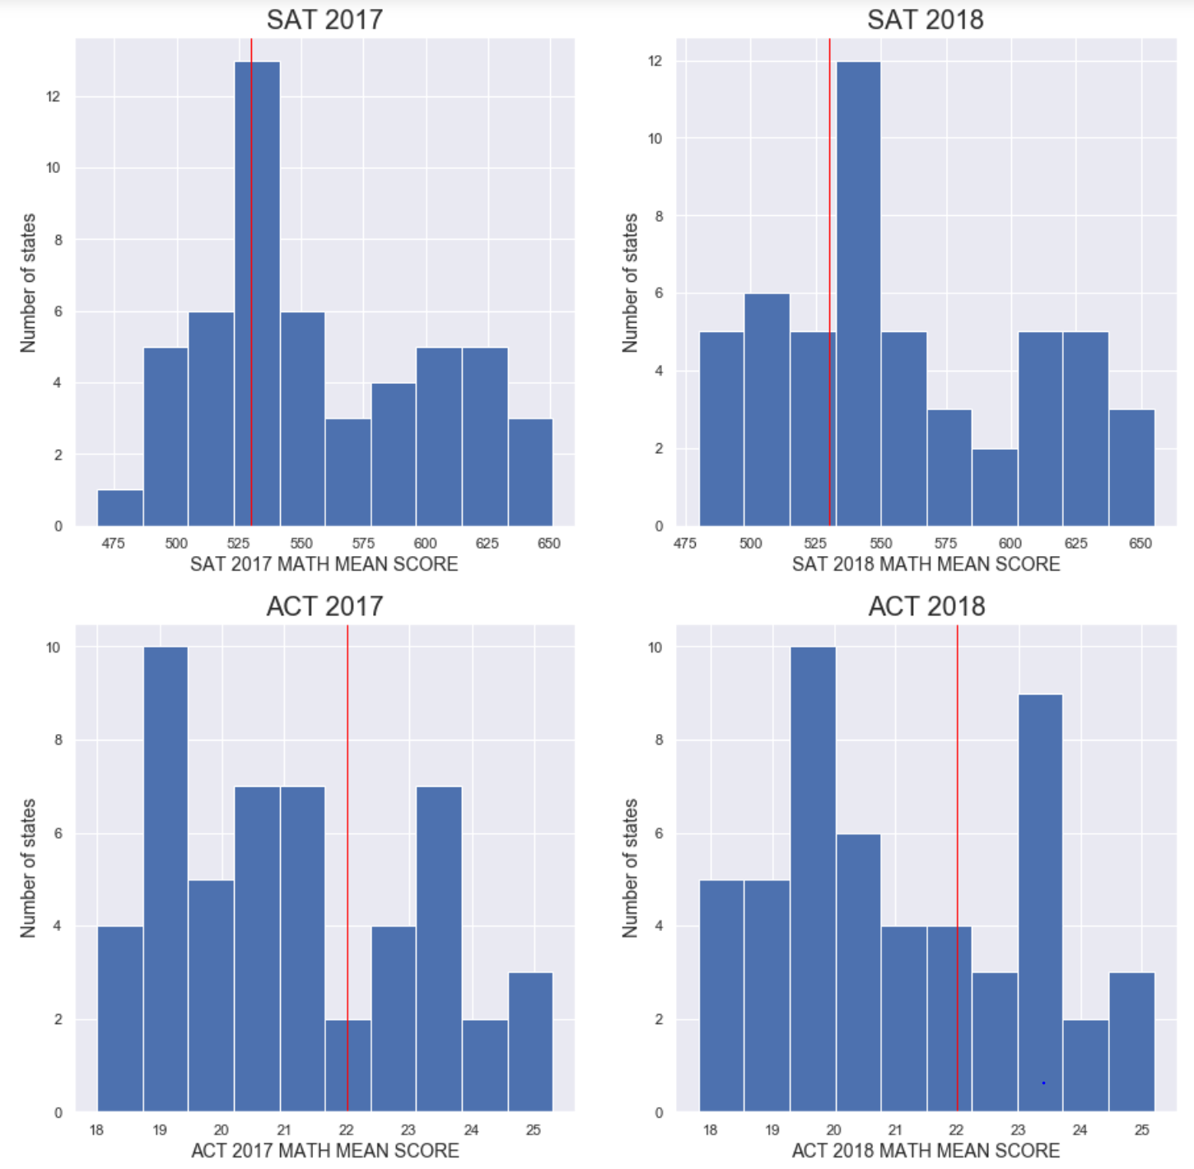
Mathematics

Slide 11
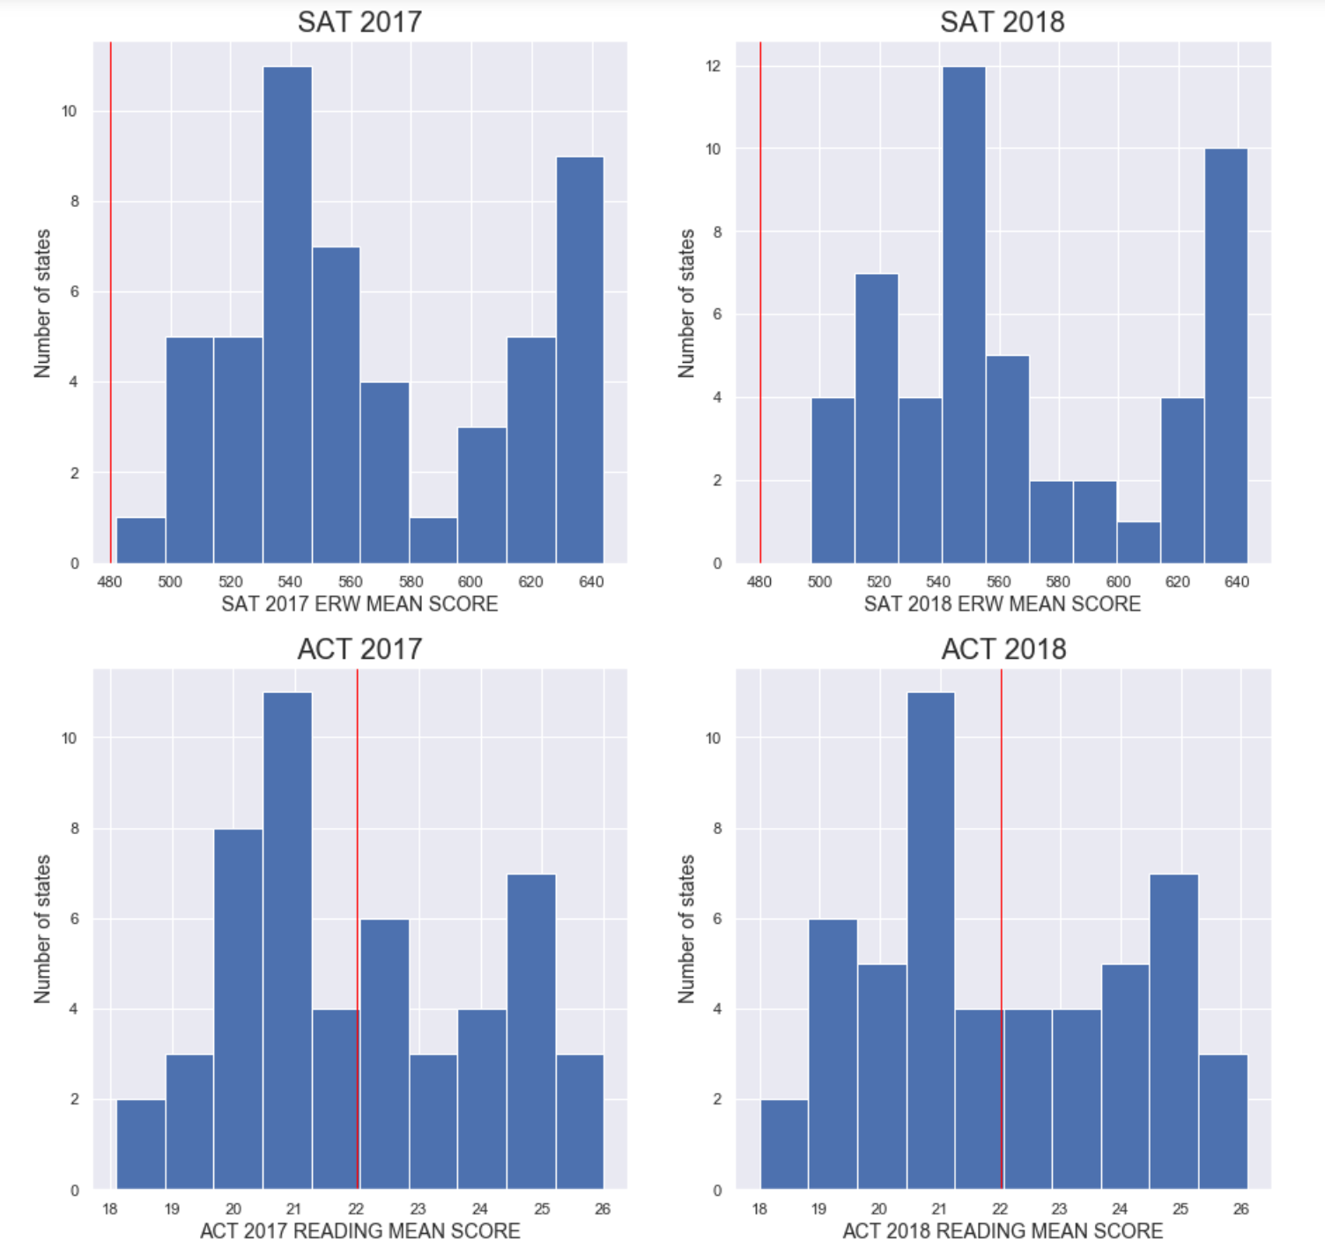
ERW vs Reading

Slide 12
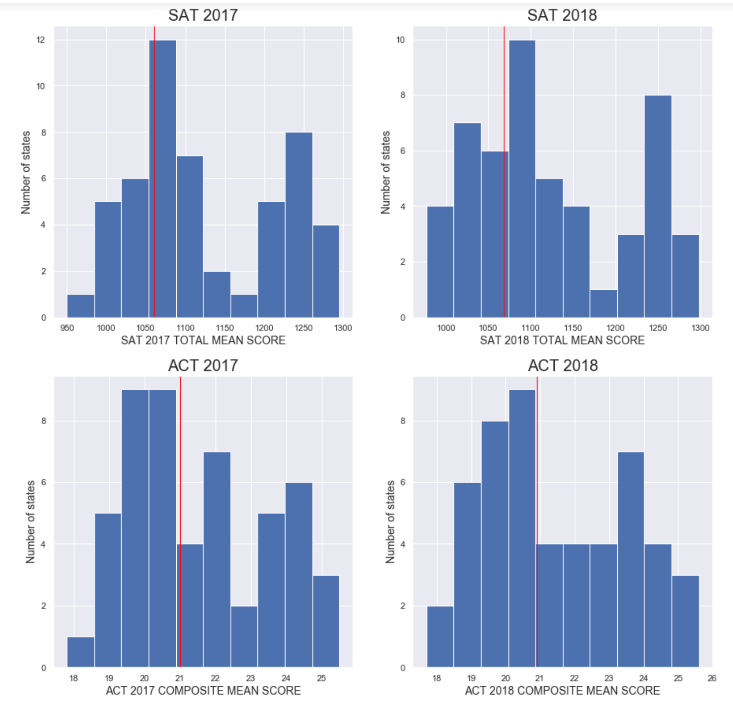
Total Mean vs
Composite Mean

Slide 13
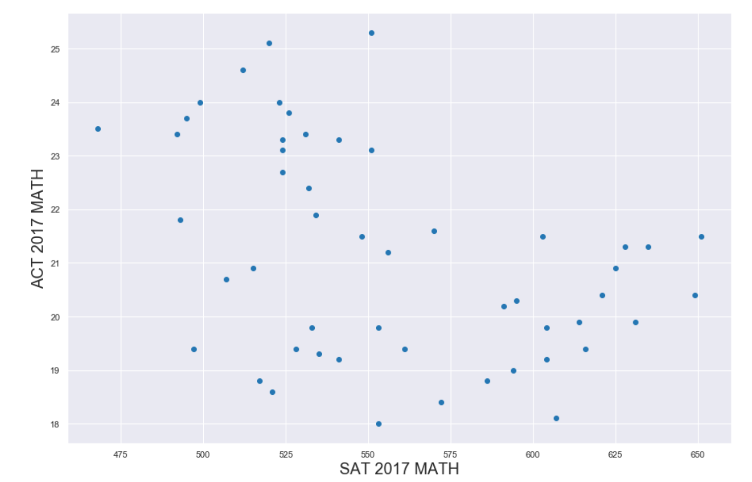
ACT Math vs
SAT Math
2017

Slide 14
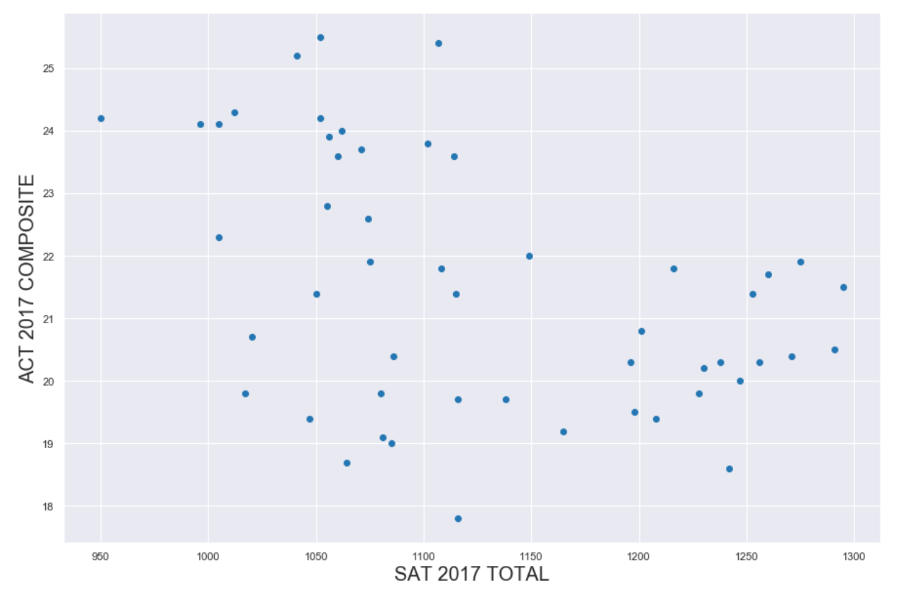
ACT 2017 Comp
Vs
SAT 2017 Total

Slide 15
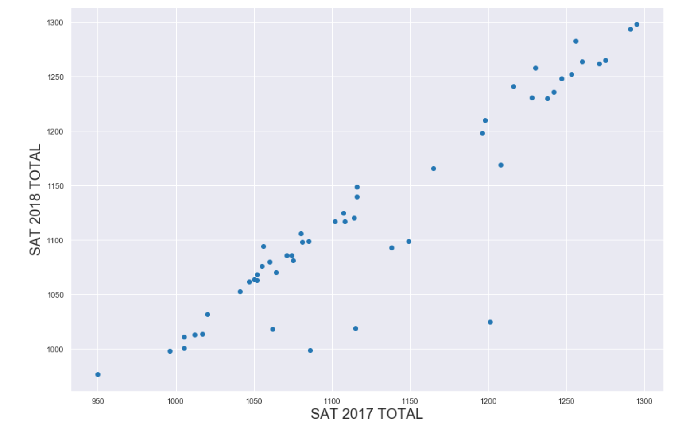
SAT 2018 Total
Vs
SAT 2017 Total

Slide 16
SAT 2018 Total
Vs
SAT 2017 Total

Slide 17
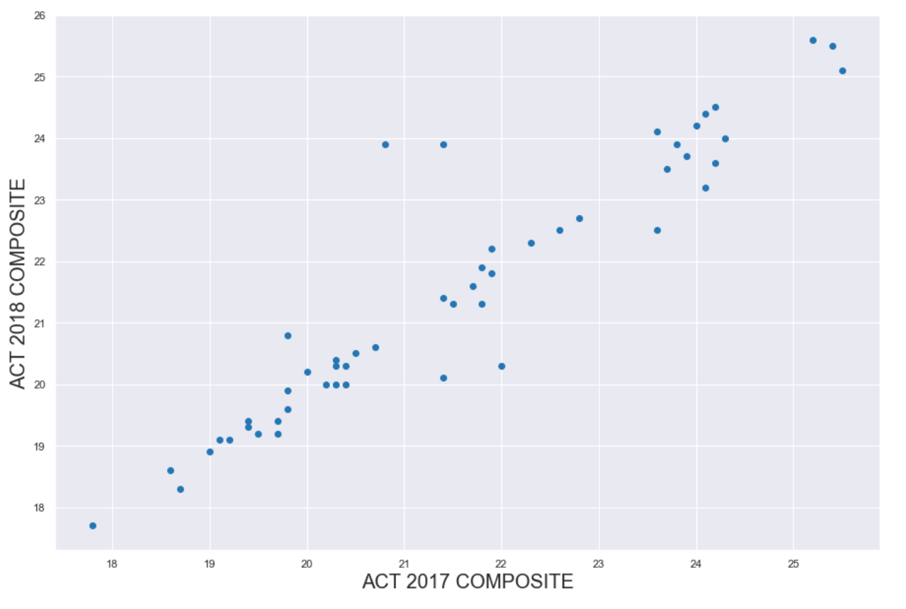
ACT 2018 Comp
Vs
ACT 2017 Comp

Slide 18
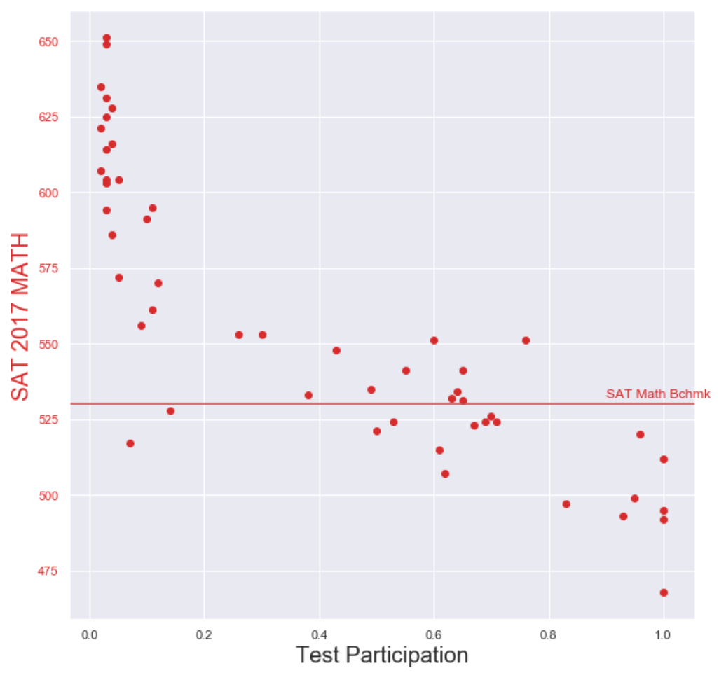
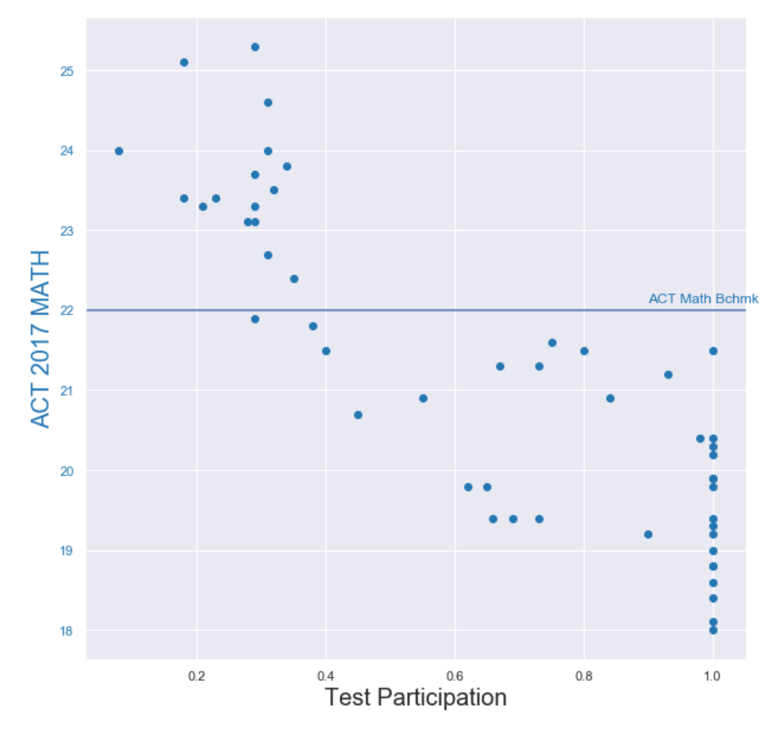
SAT & ACT MATH 2017 vs Benchmarks

Slide 19
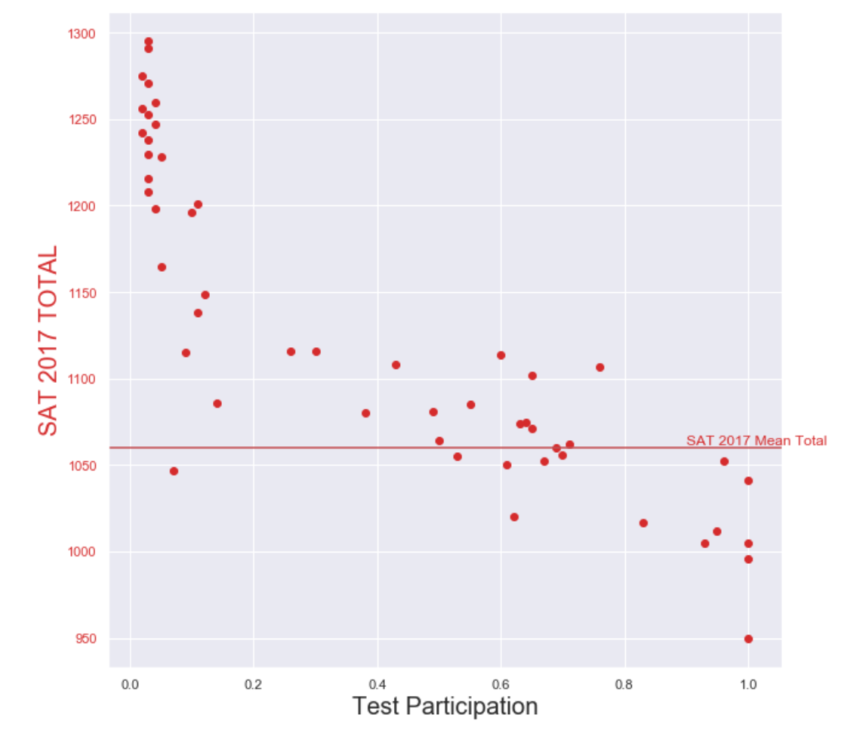
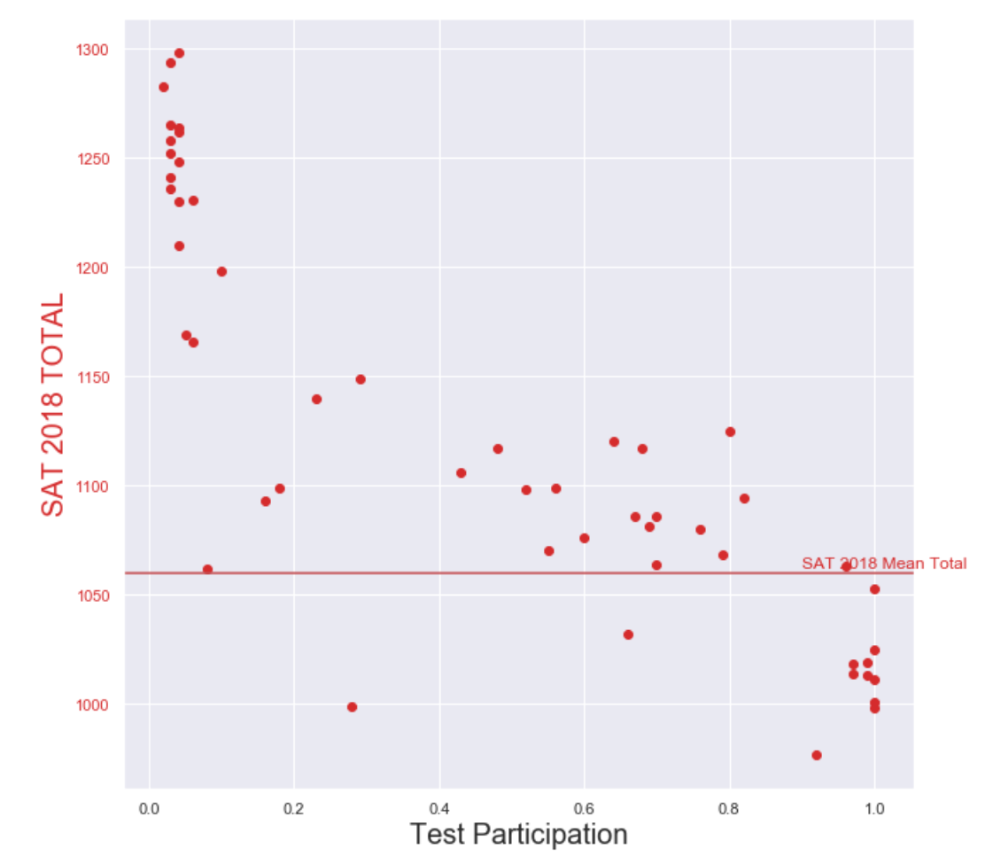
SAT TOTAL 2017 – 2018 vs Benchmarks

Slide 20
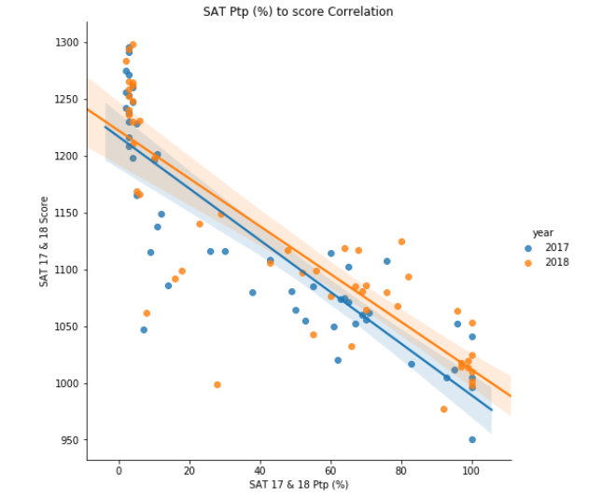
SAT TOTAL 2017 & 2018 vs PArticipation
Correlation is flattening
This suggests the change in SAT test structure is normalising results

Slide 21
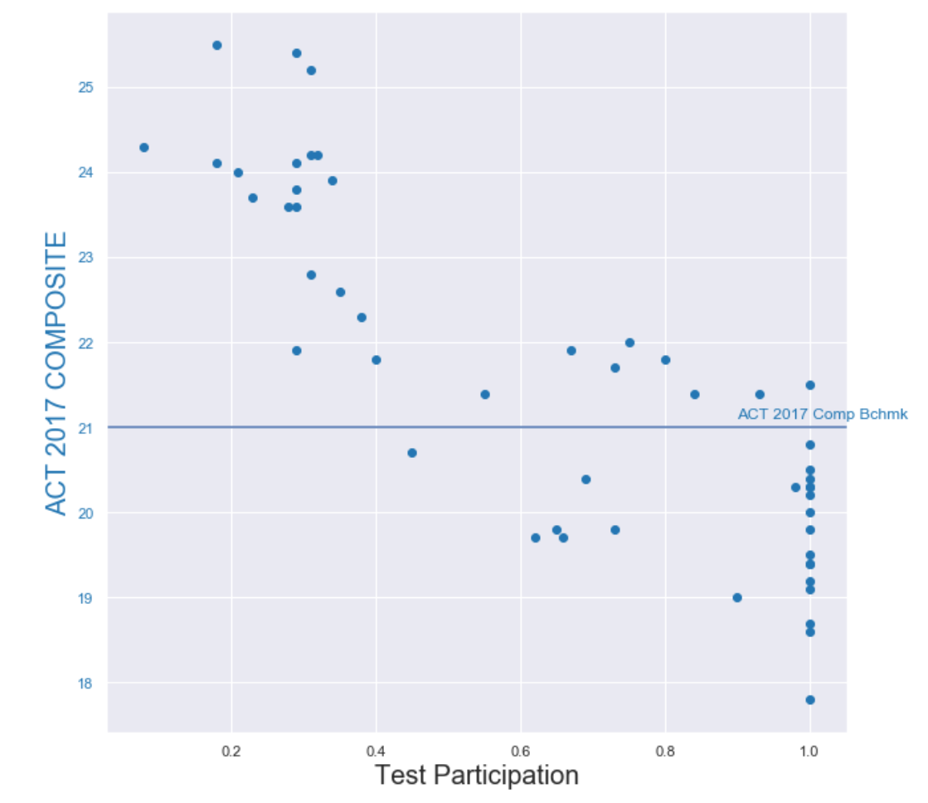
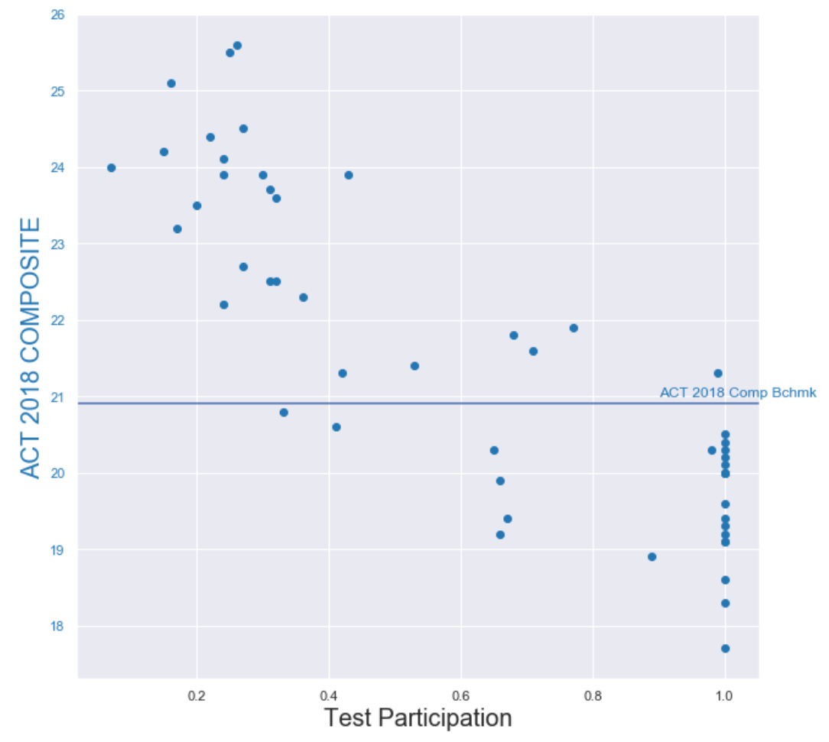
ACT TOTAL 2017 – 2018 vs Benchmarks

Slide 22
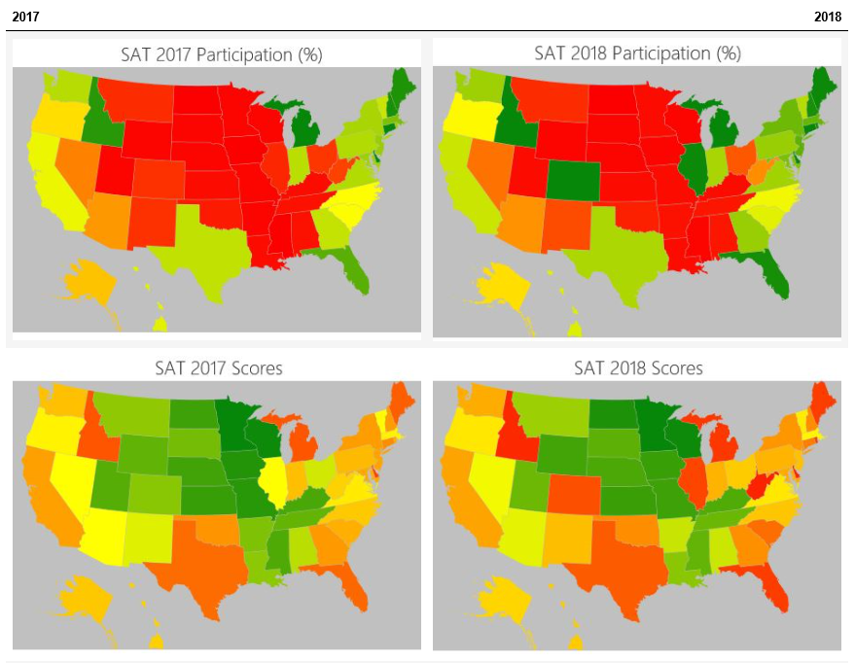
SAT TOTAL 2017 & 2018 vs Participation

Slide 23
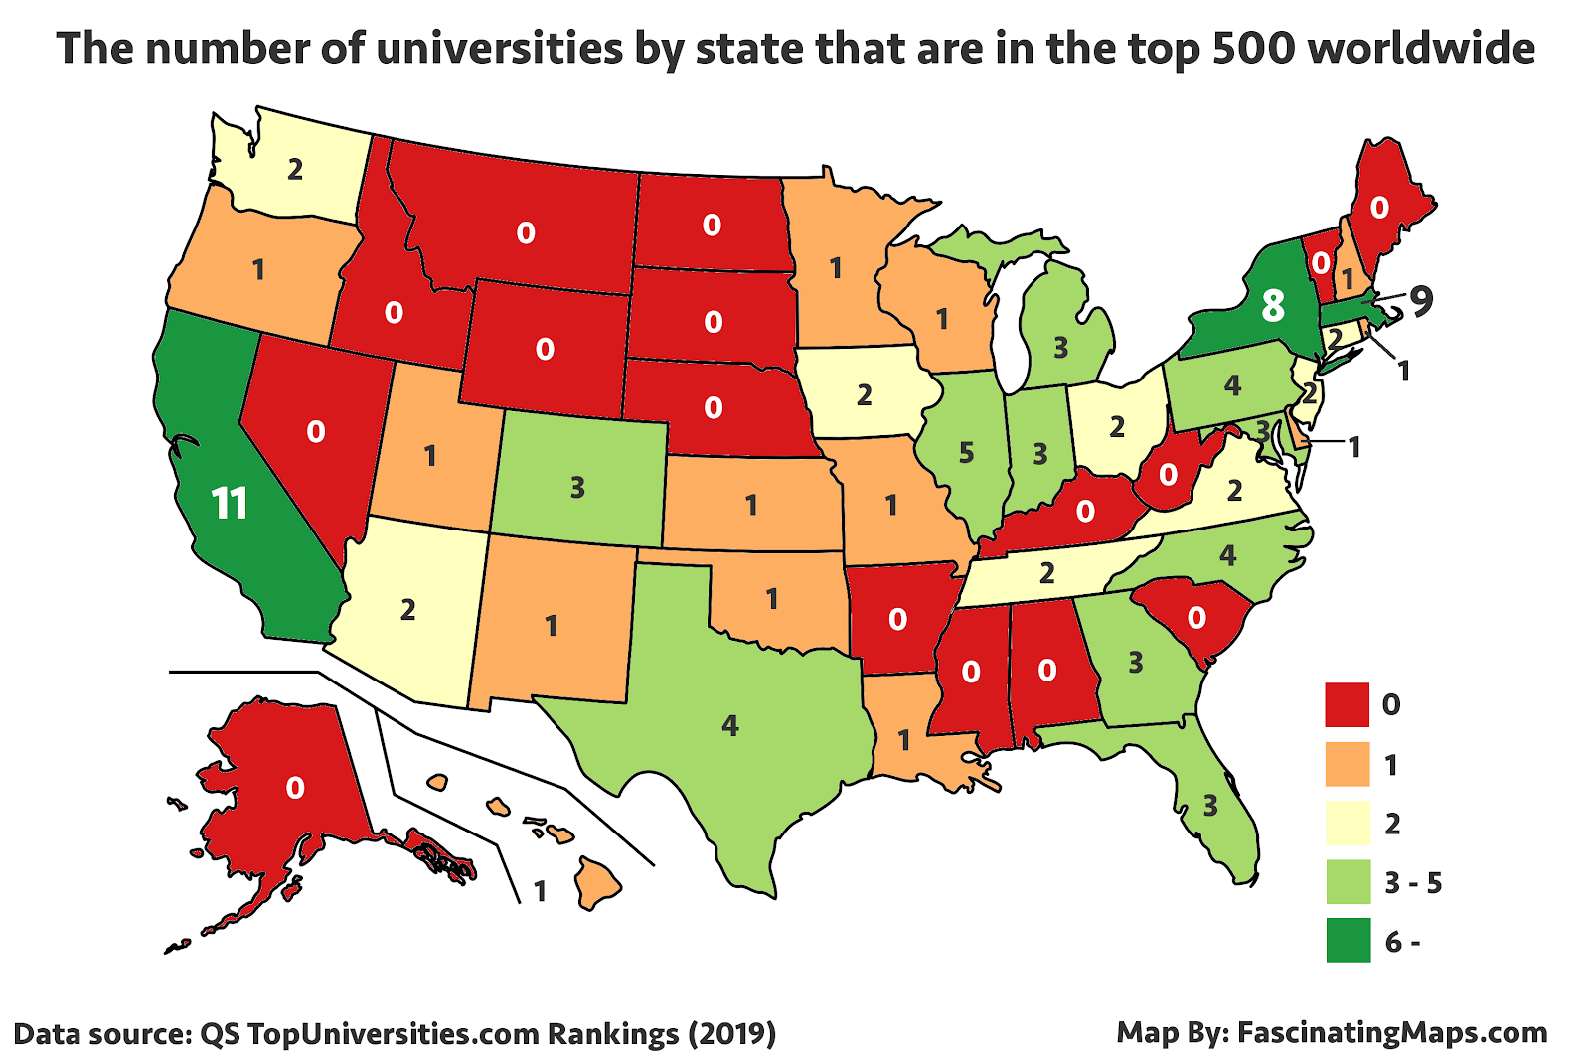
SAT Participation vs top US Unis
Source: https://fascinatingmaps.com/top-500-universities-by-us-state/

Slide 24
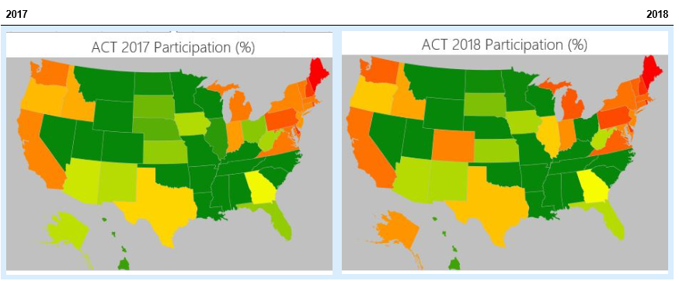
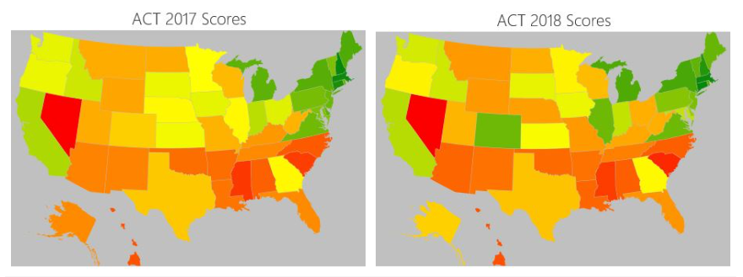
ACT TOTAL 2017 – 2018 vs Benchmarks

Slide 25
SAT TOTAL 2017 & 2018 vs Participation
Source: https://fascinatingmaps.com/top-500-universities-by-us-state/

Slide 26
Scores vs Test Participation
Benchmarks
Many states do not meet the ACT benchmarks or SAT Benchmarks for each test.
Most state mean SAT Total scores are at or above the national mean.
Approximately half of all ACT state mean composite scores are at or above the national benchmark.
As participation levels increase, mean Total and Composite scores decrease.

Slide 27
Scores vs Test Participation
Participation
Numerous states have full participation in the ACTs and SATs.
More "normal" results are included where all students participate in the tests, thus lowering the state averages
Most states with high mean scores have low participation rates.

Slide 28
Relationship: SAT & ACT Participation
It could be a justifiable comparison because:
Same kind of metric
Participation for test used in college admissions
Exactly the same scale (0.00 to 1.00)
It is possible to establish a reasonably accurate correlation value.

Slide 29
Relationship: SAT & ACT Participation
However, without additional data, further issues can crop up.
Issues:
They are not entirely independent variables.
Test participation rules and incentives vary across the states
Geography influences test participation
Each is a major exam that can be used for college admission
Taking one test likely means not taking the other
SATs are more recognised for university admissions worldwide

Slide 30
Relationship: SAT & ACT Participation
Issues (Cont’d):
Populations of each state are not reflected alongside participation data.
Some states, such as Florida, have high populations (147,058 students).
High population more likely to drastically lower mean scores than for a less populous state
147,058 students in Florida vs. 14,834 students in Rhode Island
SAT and ACT participation have a strong negative correlation with each other (approx. -0.8)

Slide 31
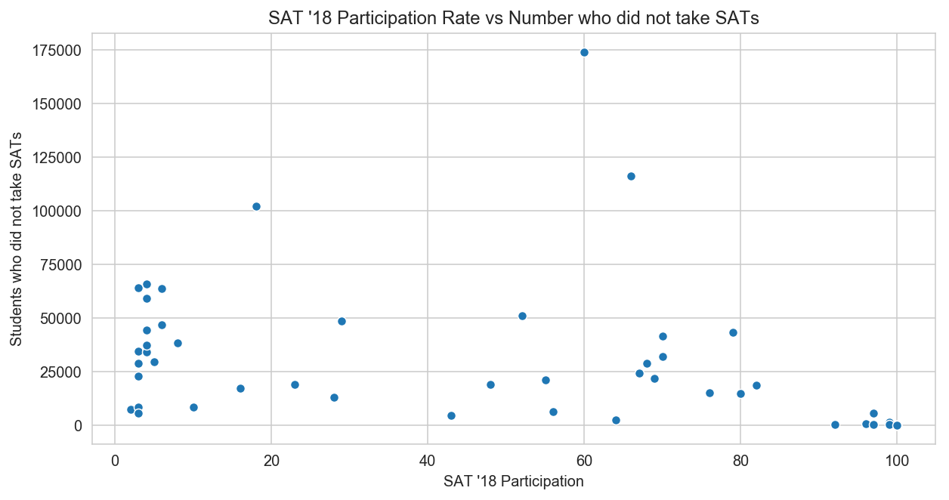
Relationship: SAT & ACT Participation
Participation rates have no relation to absolute number of students taking/not taking test.

Slide 32
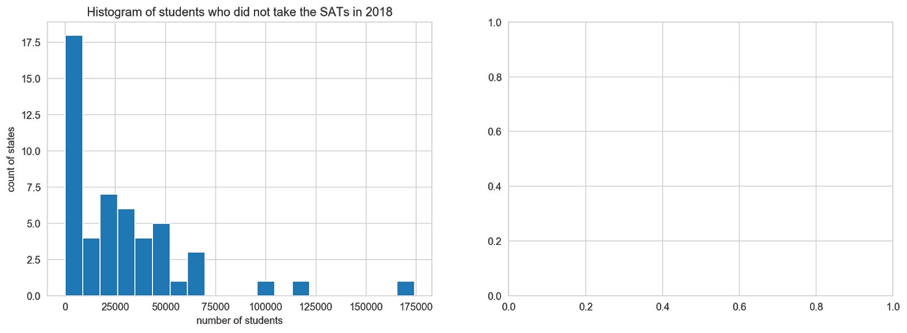
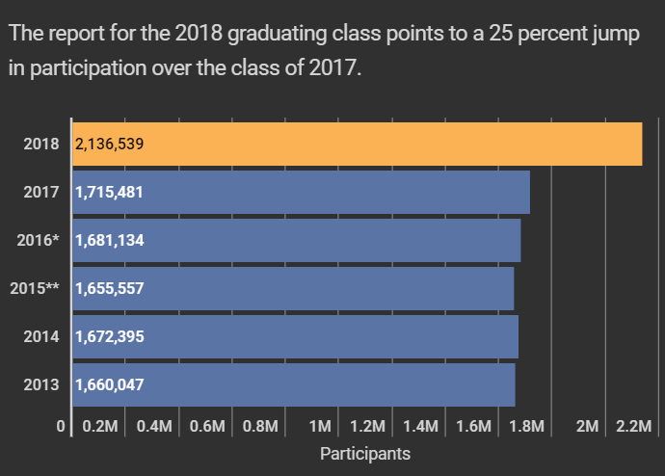
Relationship: SAT & ACT Participation
Source: https://www.edweek.org/ew/articles/2018/10/31/sat-scores-rise-as-number-of-test-takers.html

Slide 33
Relationship: SAT & ACT Participation
From participation rates, it is not immediately obvious how many students took either test for each state
Participation rates alone do not fully explain changes in mean scores
The number of students taking the test gives context to participation rates and changes in scores.

Slide 34
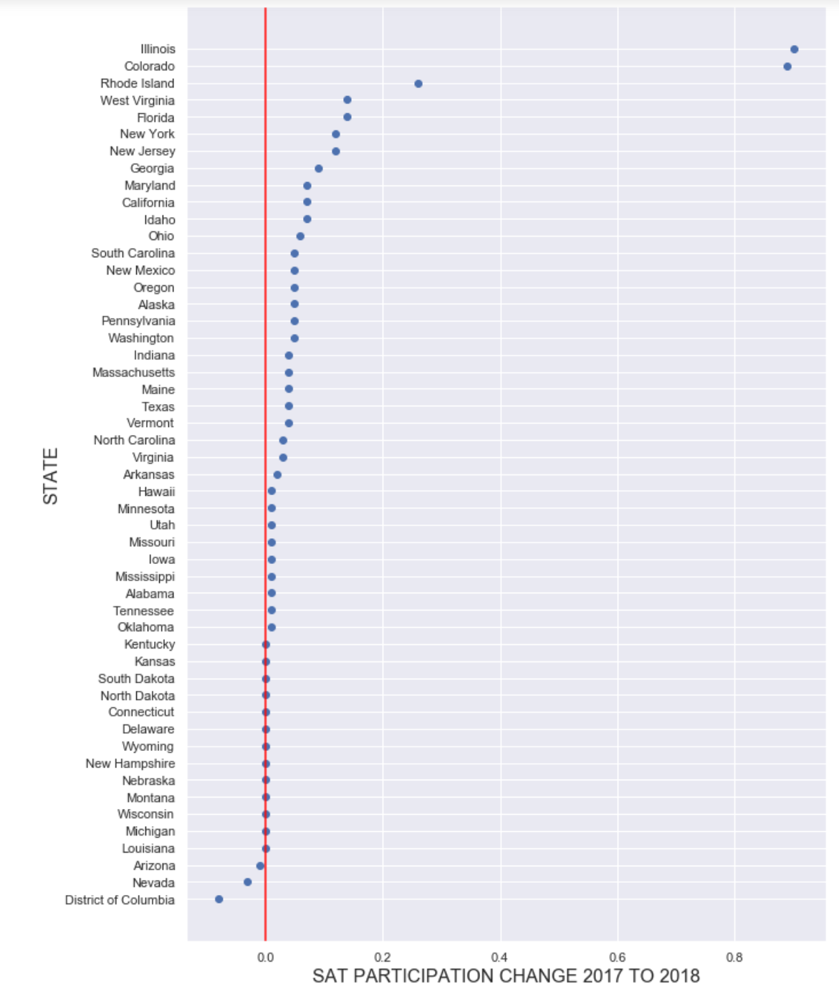
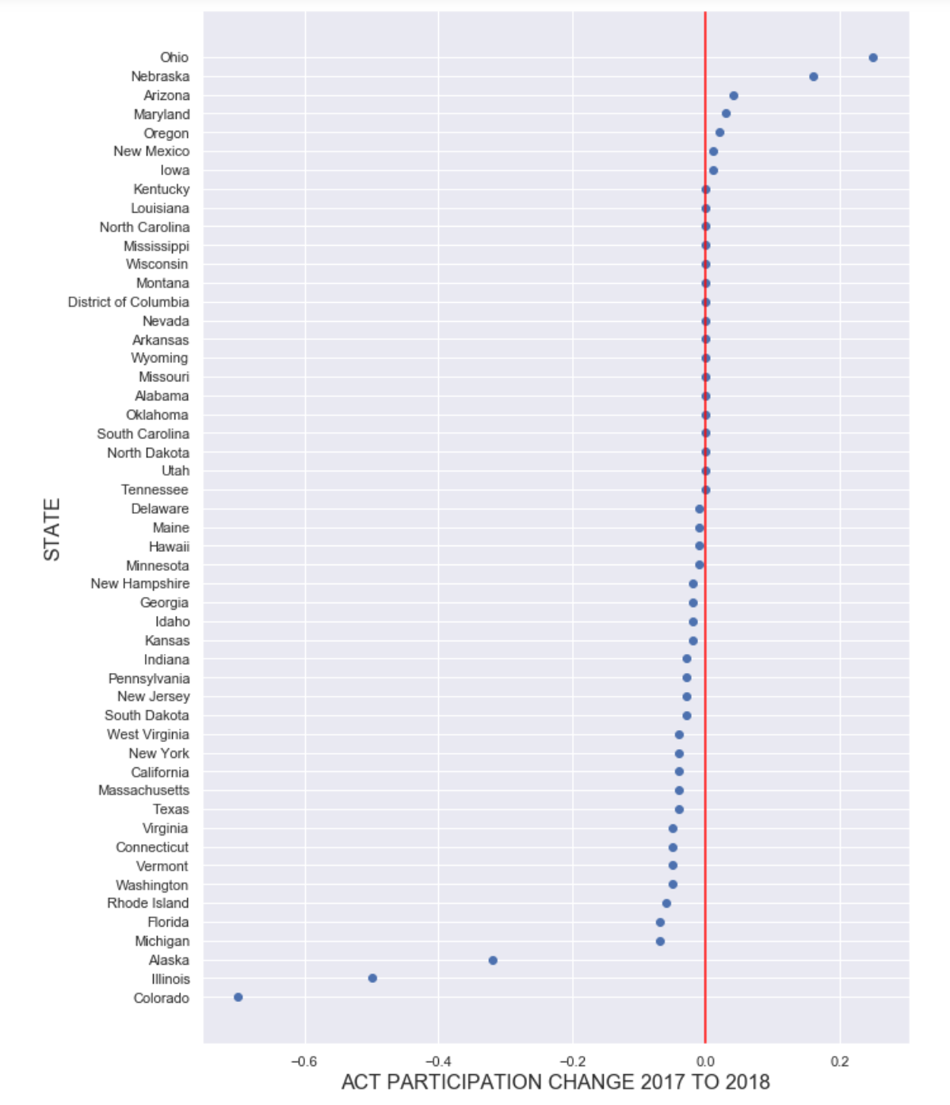
Impact of Change: Participation

Slide 35
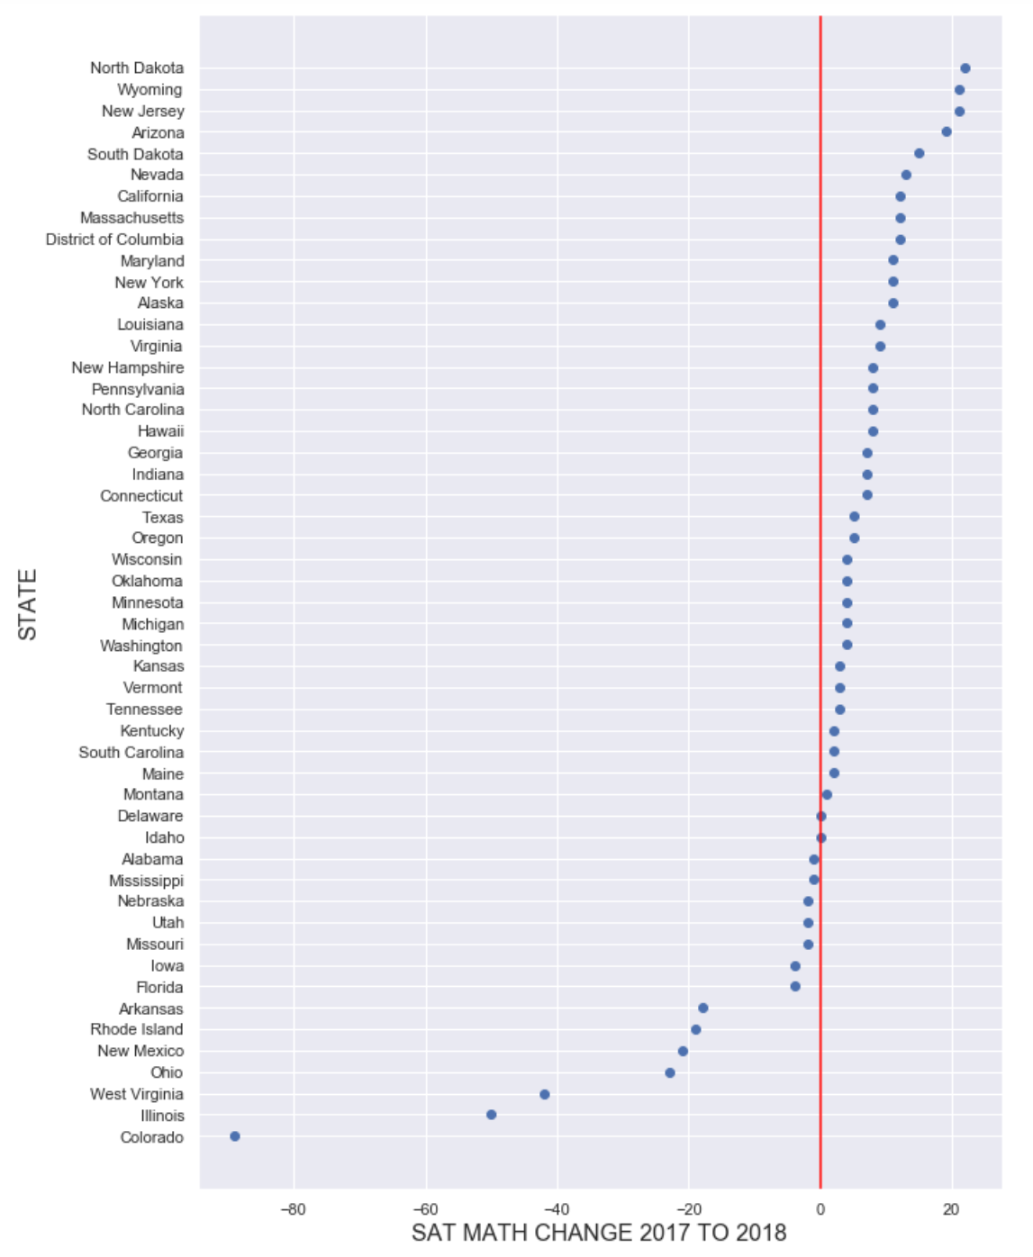
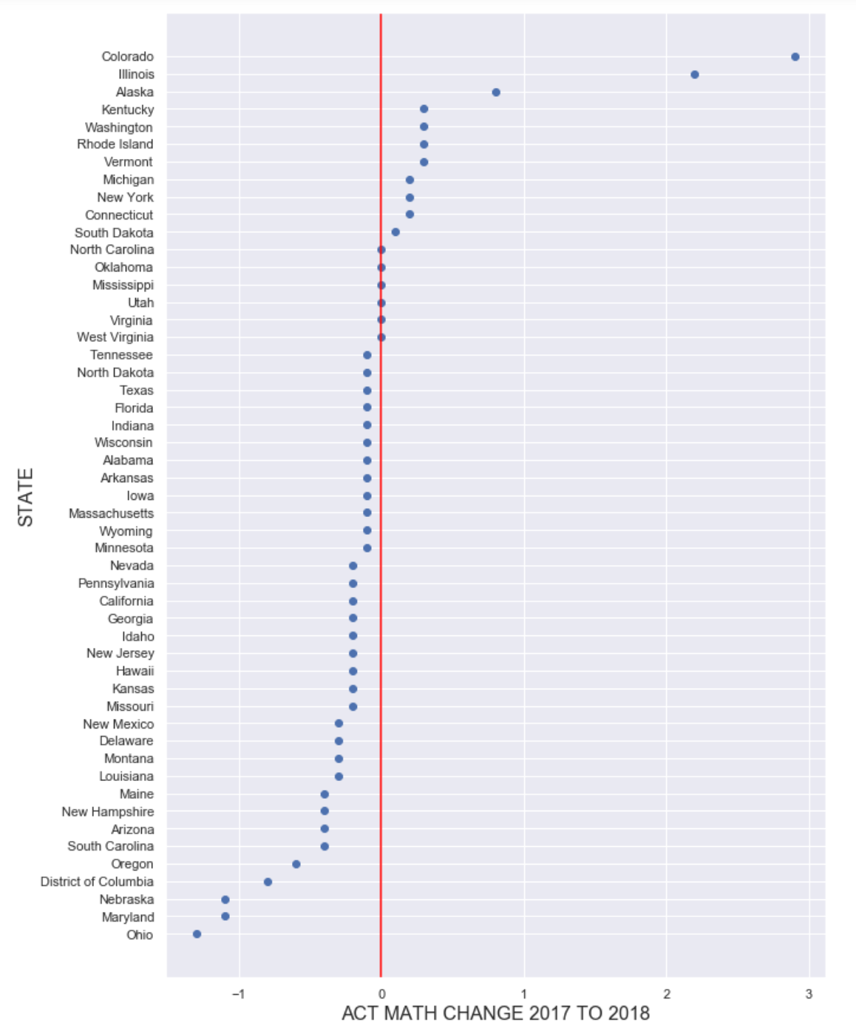
Impact of Change: Mathematics

Slide 36
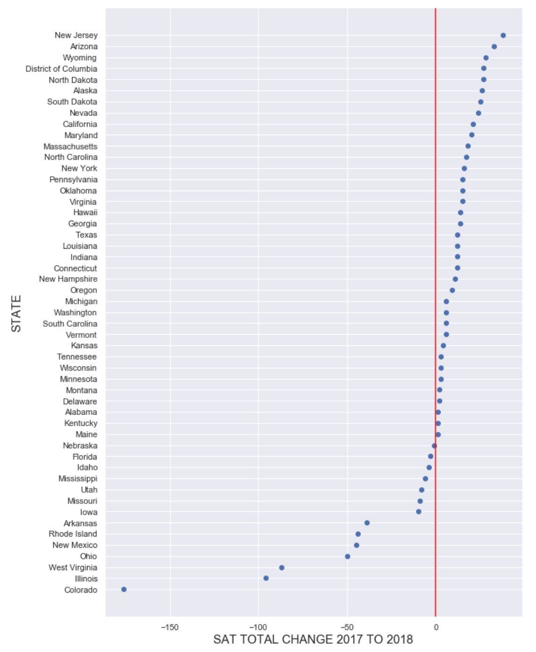
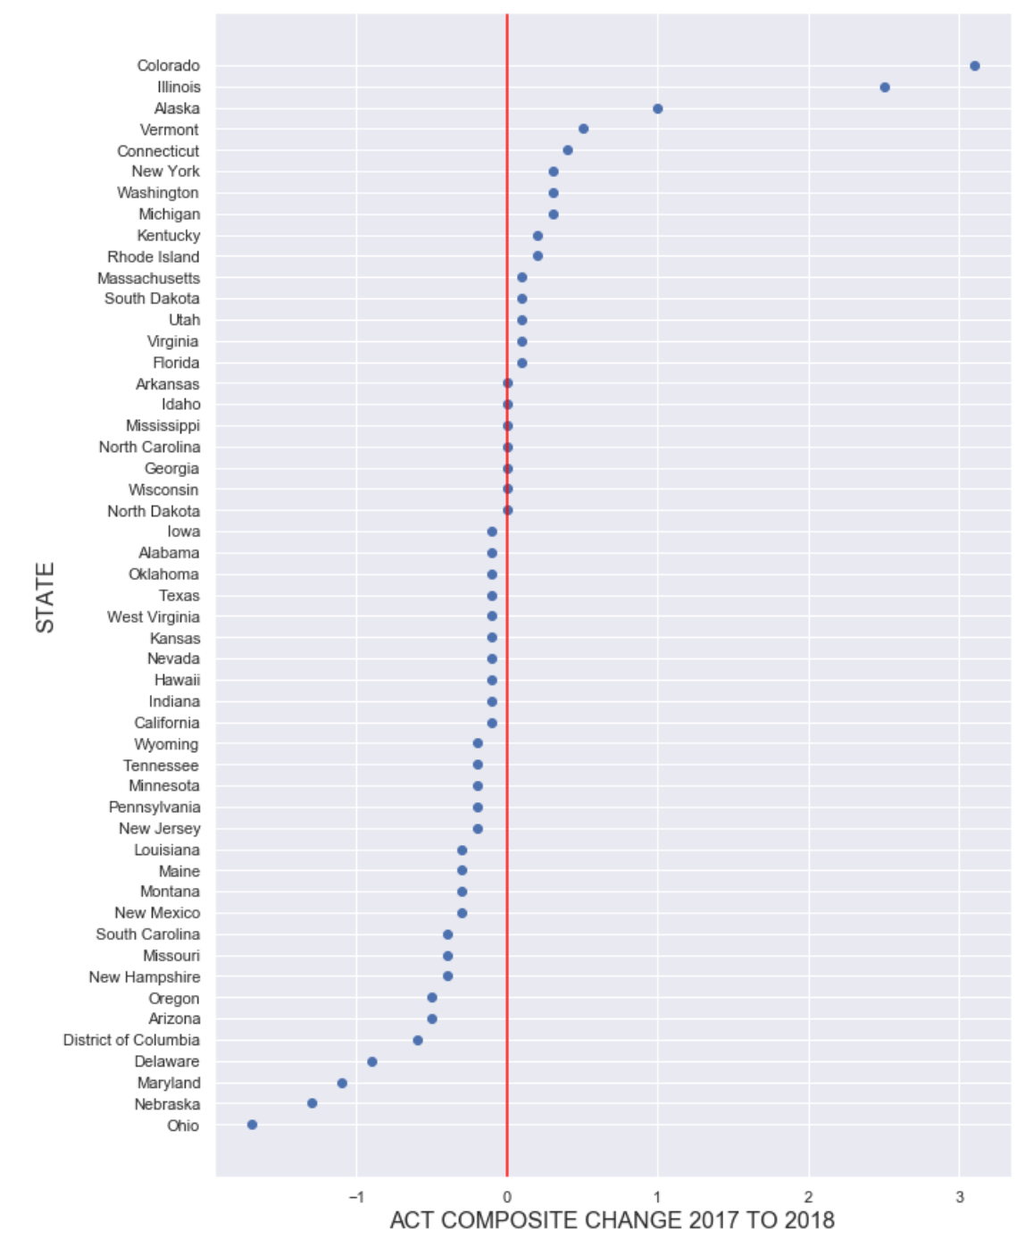
Impact of Change: TOTAL and Composite

Slide 37
States to WAtch
Illinois
Colorado
Alaska

Slide 38
States to WAtch
Illinois
State government of Illinois made the SATs compulsory and started phasing out the ACT in 2016
Students were strongly incentivised:
State sponsorship
Tested at taker’s convenience

Slide 39
States to WAtch
Colorado
Similar to Illinois, the state of Colorado signed a contract with the College Board to adopt and push the SAT in 2016.
Students were strongly incentivised:
State sponsorship
High convenience

Slide 40
States to WAtch
Alaska
Saw a large drop in ACT participation rates because the ACT was "losing ground" nationwide.
Major geographical challenge: far away from top universities in USA

Slide 41
States to Watch
Interesting observations:
All 3 states saw sharp dips in ACT participation
All 3 states saw the largest increases in mean scores for the ACTs
This supports the idea that, to an extent:
Increased participation lowers overall means scores and
Decreased participation raises overall mean scores

Slide 42
Conclusion
Changes to SAT test structure have had a major impact on the US education system.
Whether it is positive and long-lasting is inconclusive for now.
More samples are required for accurate predictions.

Slide 43
Recommendations to College Board
Continue reviewing how the new SAT format affects participation levels and test scores.
More data required to make more conclusive analysis
Factor in student populations (absolute numbers) in data to give context to participation levels
To ensure future dominance, ensure higher adoption of SAT now
Obtain more government contracts for delivery of SAT exams

Slide 44
One state to look out for
District of Columbia
DC’s SAT participation rate saw a decrease with no perceptible corresponding increase in ACT participation rates.
Possible that DC students may be taking alternative tests such as the ACT and PARCC.
College Board could try negotiating with private colleges to offer more incentives to take SAT:
More scholarship money
Better perks
Prestige

Slide 45
Key Takeaways
Data loses its meaning without context.
Research can explain numbers, but numbers cannot tell a story by themselves.
EDA helps you understand your data and what areas to research in order to make your analysis more accurate.
The more similar the dependent variables of two datasets, the more equitable the comparison.
Craft a good problem statement:
Essential for effective and efficient execution of EDA.

Slide 46
Questions?

Slide 47
Thank you!

Slide 48
References
Business Insider: SAT is changing the format of its test in 2016
College Board's official report on the SAT re-design
https://www.act.org/content/dam/act/unsecured/documents/pdfs/R1670-college-readiness-benchmarks-2017-11.pdf
https://collegereadiness.collegeboard.org/about/scores/benchmarks
https://blog.prepscholar.com/average-sat-scores-by-state-most-recent
https://www.edweek.org/ew/section/multimedia/states-require-students-take-sat-or-act.html
https://www.chicagotribune.com/news/ct-illinois-chooses-sat-met-20160211-story.html
https://www.washingtonpost.com/education/2018/10/23/sat-reclaims-title-most-widely-used-college-admission-test/
https://www.edweek.org/ew/articles/2018/10/17/math-scores-slide-to-a-20-year-low.html
https://www.act.org/content/dam/act/secured/documents/cccr2018/National-CCCR-2018.pdf
https://www.edweek.org/ew/articles/2018/10/31/sat-scores-rise-as-number-of-test-takers.html
https://fascinatingmaps.com/top-500-universities-by-us-state/

